Slide 1
An integrated high-level hardware/software partitioning methodology
By Cliff Kirkman
Notes:
The topic I have chose is a study an integrated high-level hardware/software partitioning methodology, to begin with I am going to go through what it is, why you would want to use it, how it relates to embedded systems and then more importantly how it relates to parallel computing.

Slide 2
Introduction and Motivation
What is an hardware/software partitioning methodology?
The target technology for this software is Field Programmable Gate Arrays (FPGAs) and other programmable hardware
Why would you want to use hardware/software partitioning?
To save time and resources when designing systems which use programmable parts e.g. FPGAs
Speed up time-to-market
Save development costs
Easy to use design tool integrated to CAD – Designed can interact with tools to effect or modify outcome
More factors are considered and less likely to be missed
Partitioning happens quickly within a predictable time frame
Notes:
What is an hardware and software partitioning methodology?
When developing a product you must consider what features will be implemented using hardware and what ones will be implemented using software, the idea behind this study is to implement a peace of software which can automated this decision process.
The main focus of this presentation is on how this has been accomplished, using a variant of partial swam optimization.
The target technology for this methodology is Field Programmable Gate Arrays (FPGAs) and other programmable hardware
Why would you want to use one?
The main reason is to save time and resources when designing systems which use programmable parts e.g. FPGAs
Here you can see the benefits of using a partitioning tool.
This can be proven by the time it takes a product to get to market, since our industry is very fast moving this can be very important to share holders.
Using this methodology and combining it with automation and parallel computing you can save money on development costs.
CAD is a widely used piece of software which many developers are already familiar with, having this tool integrated with CAD makes it easier to use.
It can be used to help calculate development costs of a both types of implementations, buy not just the currency value but costs of all areas are considered for example: area, delay, latency, and power consumption.

Slide 3
HW/SW partitioning
Factors considered by partitioning algorithm:
Application domain, taking into consideration if the algorithm is multi-domain or specific domain
Architecture type, different approaches work differently on different architectures
Communication costs, speed at which different method communicate can be important
Choosing implementation based on alternative hardware nodes
Choosing implementation based of sharing resources, amongst more than one node
Using the abilities of hardware and software parallelism
Mode type, single or multi-mode system
Decisions based on parallelization factors
Notes:
Factors of optimized partitioning algorithms:
Application domain, taking into consideration if the algorithm is multi-domain or specific domain
Architecture type, different approaches work differently on different architectures
Things work differently on different architectures, one architecture type may lend itself better to hardware nodes and one may lend itself better to software nodes
Communication costs, speed at which different method communicate can be important
For example one type of hardware communicating faster than its software counterpart
Choosing implementation based on alternative hardware nodes
There may be more than one node capable of doing a specific job, the tool can consider this and decide which one to use.
Choosing implementation based of sharing resources amongst more than one node
When there is an option to share resources it can improve the performance of a node
Using the abilities of hardware and software parallelism
The algorithm also considers how software or hardware will parallelise tasks, some nodes can work in parallel better than others.
Based on these factors the partitioning tool was built to find most efficient cost.

Slide 4
Introduction to Particle Swarm Optimization(PSO) algorithm
How PSO is used to solve partitioning of hardware and software design?
Solutions are found at random to begin with, then based on solution results over each iteration, by following current best solution the most optimal one can be found
How it’s specifically used for hardware and software partitioning methodology:
Generate set of solutions with random amount of serial nodes, parallel nodes and level of power implementation
It takes the best results from each iteration and generates another solution
Keep repeating until optimal solution is found, indicated by 50 rounds of no improvement
Notes:
How PSO is used to solve partitioning of hardware and software design?
PSO is an algorithm inspired by animal social behaviour like bird flocks, birds try to find food together, once some food has been found in specific area more birds look in that area.
Solutions are found at random to begin with, then based on solution results over each iteration by following current best solution the most optimal one can be found
How it’s specifically used for hardware and software partitioning methodology:
Generate set of solutions with random amount of serial nodes, parallel nodes and level of power implementation
After each round based best performances, generate new set with similar amounts
Keep repeating until optimal solution is found or set number of rounds is met

Slide 5
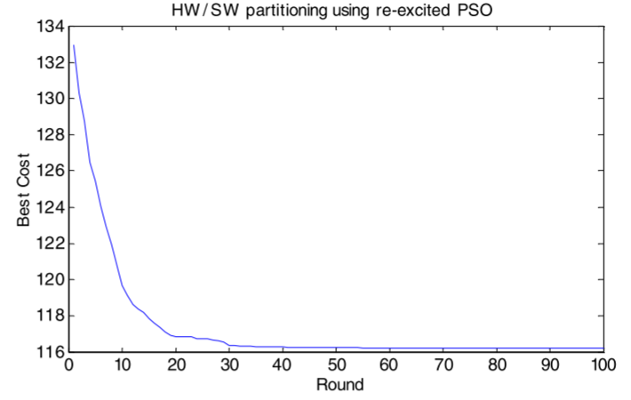
Example results of HW/SW partitioning using re-excited PSO
PSO runs again with new data holding best results from previous rounds
Generates new solution and compares against previous solutions, to help improve further improve results
Notes:
In this paper a new variant of PSO is purposed called re-excited PSO.
With complicated solutions the best ones are not always found using normal PSO.
This re-excited PSO works by starting over, with a new set of data well keeping the best result vectors from previous rounds, this is to allow further refinement.
Essentially just giving the data set new random positions well being aware of old best solution to determine if there are any better ones to be found.
“In nature, this algorithm looks like giving the birds a big push after they are settled in their best position. This push re-initializes the inertia and speed of the birds so they are able to explore new areas unexplored before. Hence, if the birds find a better place, they will go there; otherwise they will return to the place from which they were pushed.” 3.2
Example of improvements over PSO runs, shows after first 10 there is a dramatic increase in optimal cost, the improvements after this are minimal. It shows what an effective solution this is.
Using traditional PSO method, the cost would of ended up being 134 using re-excited method cost improved to 116.

Slide 6
Different types of cost used to calculate best solution
Area cost
Hardware – number of gates, space it takes up and number of logic elements
Software – CPU area used
Delay cost
How long it will take to execute
How many clock cycles it will take to complete
Communication cost
The time it takes to communicate between nodes when using shared memory
Power cost
Hardware - How much electricity the component uses
Software - How much CPU processing power
Notes:
Different types of cost to be considered
The solution of the algorithm is based on the cost factor of each component.
Area cost for hardware is calculated based on number of gates, the physical space it takes up and number of logic elements
Delay cost considers how long it will take to execute and how many clock cycles it takes to complete
Communication cost is the time it takes to communicate between nodes when using shared memory
Power cost for hardware is calculated based how much electricity a component uses, for software its how much CPU processing power is used.

Slide 7
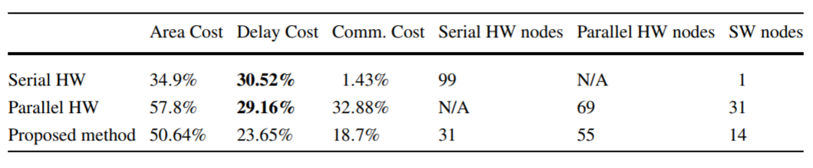
cost model results
Factoring in cost areas this is a test case designed to find the optimal amount of serial and parallel HW nodes out of 100, to create the best overall cost
Serial = Low area, high delay and low communication
Parallel = High area, medium delay and very high communication
Proposed method (Mixture) = medium area, low delay and medium communication
Notes:
Factoring in cost areas this is a test case designed to find the optimal amount of serial and parallel HW nodes out of 100, to create the best overall cost
The serial line has the smallest area cost since there is only one software node taking up CPU space, it has the highest delay since because it takes time to execute the hardware nodes and since these are all serial hardware nodes, which doesn’t communicate with one another, the communication cost is low.
The parallel line shows the highest area cost, and lowest delay cost. The biggest problem with the parallel solution is the high communication cost this is due to a large amount of nodes working in parallel.
The proposed method demonstrates a mixture of each node type, this would be the best method to choose if you were looking for the lowest delay.
The results of this model show the best solution depending on which cost area you favour the most.

Slide 8
Real life Case study
Purpose of case study is to test out PSO algorithm, against real world hardware and software
Based on creating a JPEG encoding system
Only RGB to YUV aspect has to already be implemented in SW, all other aspects are subject to partitioning process
Measurements have been obtained for hardware cost via implementing the HW on ML310 board using Xilinx ISE 7.1i design platform
Measurements have been obtained for software cost via Xilinx Embedded Design Kit (EDK 7.1i)
Notes:
Since this is a large paper I have chosen to cover the first of the two case studies which mainly focuses on re-excited PSO, rather than the second which focuses on the flexibility of the CUPSHOP tool as a whole.
10/32 3.4 case study
Explain JPEG coder case study
An attempt to use partitioning tool to obtain optimal hardware to software ratio
What it did, what the results were
How parallel computation effected/benefited results
Do this over two slides, figure out how it would take to present, add summary type slide if you need to extend time. Add UWE Harvard reference for pdf

Slide 9
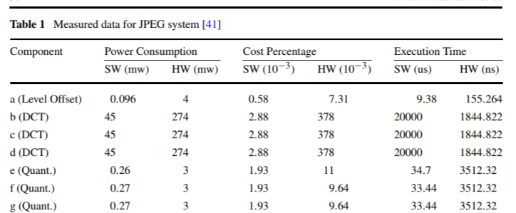
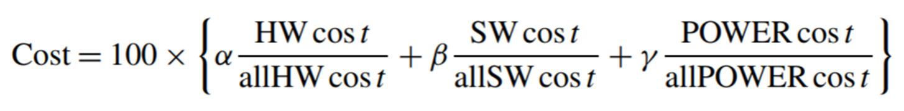
analysis of case study
Table one shows a breakdown of, Power consumption, Cost Percentage and Execution time for each component
Original algorithm was based on single core architecture, adjustments have been made to allow for multi-processor partitioning
Overall cost is generated using the same equation used in previous slides
50 solutions(particles) are attempted, a continuous loop of rounds will occur until there is no improvement for 50 rounds
Notes:
Each component has a set of values to generate cost of that individual section, we need this data to figure out how much using a particular components cost.
An adjustment is made to the algorithm to account for parallel processors, this is to alter the cost value if two or more software nodes are in the same control step, the maximum number of concurrent software tasks is two.
Since hardware components can run in parallel, the hardware delay is not additive, to calculate hardware delay by accumulating the maximum delay of each control step.

Slide 10
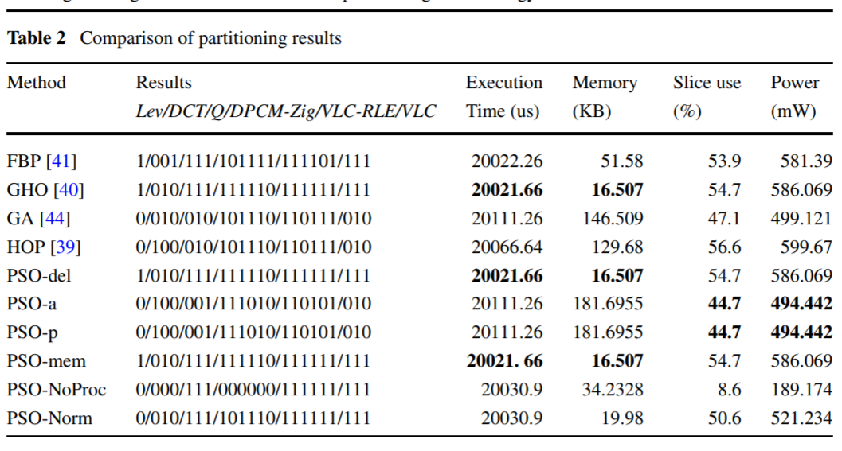
Performance analysis of case study
PSO-del, PSO-a, PSO-p, or PSO-mem only take into consideration delay, area, power or memory separately.
PSO-a and PSO-p produce the same results because they both focus on moving nodes to software
PSO-del and PSO-mem produce similar results because they both focus on moving nodes to hardware
PSO-NoProc is used to determine the optimum about of parallel processors to be used in the design
Comparing PSO-NoProc and PSO-mem you can see the main differences between doing things in parallel with hardware and software
Comparison of several different algorithms including re-excited PSO:
Notes:
Focusing on the bottom six which are all variants of the PSO algorithm, they try achieve the following:
PSO-del, PSO-a, PSO-p, or PSO-mem only take into consideration delay, area, power or memory separately, to see if optimizing by any one of these is better than optimizing by another.
PSO-a focuses on optimizing area usage and PSO-p with power usage produce the same result, this is because they both focus on moving nodes to software while adhering to the constraints of power and number of processors.
PSO-del focuses on reducing delay and PSO-mem focuses on reducing the memory usage, they both do this by trying to move nodes to hardware this is why there results are similar.
PSO-NoProc is used to determine the optimum about of parallel processors to be used in the design, when you compare the results of this to the results of the others.
Comparing PSO-NoProc and PSO-mem you can see the main differences between doing things in parallel with hardware and software
No-Proc, has much more processing power so can do more software tasks in parallel, it also uses the least amount of power when compared against all methods, since it is not using a lot of hardware components.
Mem achieves fastest execution time but it comes at the cost of using a very high amount of power, this is because the more hardware you use the more power you use. It uses less memory since more functions are completed on separate hardware modules.

Slide 11
Conclusion
This tool could help to generate software design solutions, for all areas of development. Using a refined PSO algorithm has helped to generate more accurate solutions.
Although a tool like this takes a long time to run, on a basic PC it is an automated process so it would not require labour cost. The money saved on labour could go into further optimization of the program or faster PC’s.
Notes:
This tool could help to generate software design solutions, for all areas of development. Using a refined PSO algorithm has helped to generate more accurate solutions.
Although a tool like this takes a long time to run, on a basic PC it is an automated process so it would not require labour cost. The money saved on labour could go into further optimization of the program or faster PC’s.

Slide 12
Questions

Slide 13
References
Jigang W, Srikanthan T, Chaen G (2010) Algorithmic aspects of hardware/software partitioning: 1D search algorithms. IEEE Trans Comput 59(4):532–544

